Slide 1
The proper way to color a grid
Ron Peled, Tel Aviv University
Based on works with
Nishant Chandgotia, Scott Sheffield and Martin Tassy,
with Ohad Feldheim
and with Yinon Spinka
Plenary talk
Israel Mathematical Union meeting
Hebrew University of Jerusalem
June 13, 2019

Slide 2
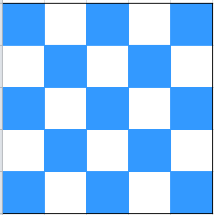
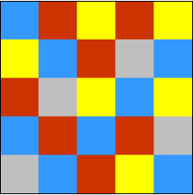
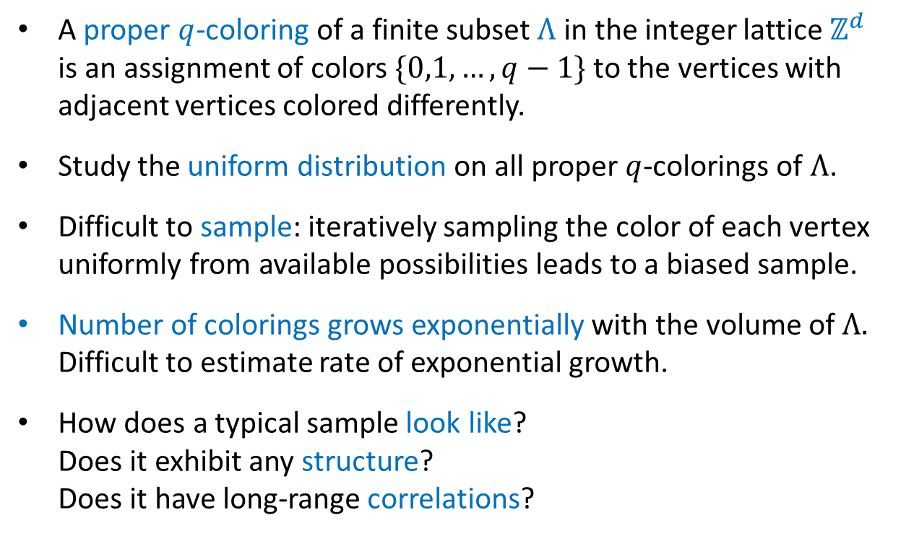


Proper colorings
A proper $q$-coloring of a finite subset $Λ$ in the integer lattice $ℤ^{d}$ is an assignment of colors $\{0,1,…,q−1\}$ to the vertices with adjacent vertices colored differently.
Study the uniform distribution on all proper $q$-colorings of $Λ$.
Difficult to sample: iteratively sampling the color of each vertex uniformly from available possibilities leads to a biased sample.
Number of colorings grows exponentially with the volume of $Λ.$ Difficult to estimate rate of exponential growth.
How does a typical sample look like?
Does it exhibit any structure?
Does it have long-range correlations?
$$q=2$$
$$q=4$$

Slide 3
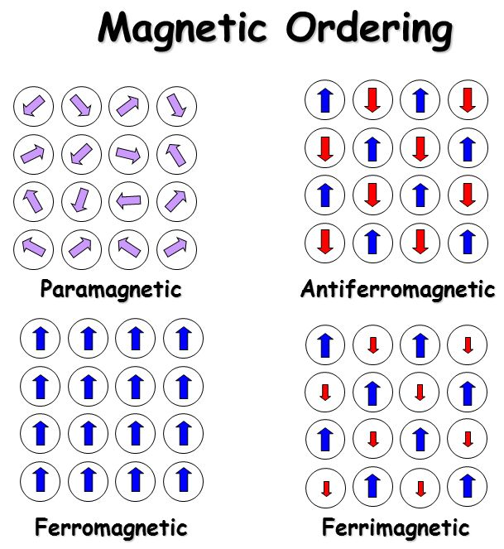



Motivation
Statistical physics: Vertices of $Λ$ are atoms/molecules of a crystal. Each atom has a magnetic spin, taking one of $q$ values.
Antiferromagnetic material – adjacent spins tend be different.
This tendency is made absolute in the zero-temperature limit.
Proper $q$-colorings = zero-temperature antiferromagnetic $q$-state Potts model.
Structure -> antiferromagnetic (Néel) order
Paradigm for statistical physics models with hard constraints.
Combinatorics: Structure in coloring is closely related to counting and sampling problems:
How many proper $q$-colorings does a grid have? How to sample a coloring uniformly at random?
$q=3$ case related to random Lipschitz functions (see later).

Slide 4
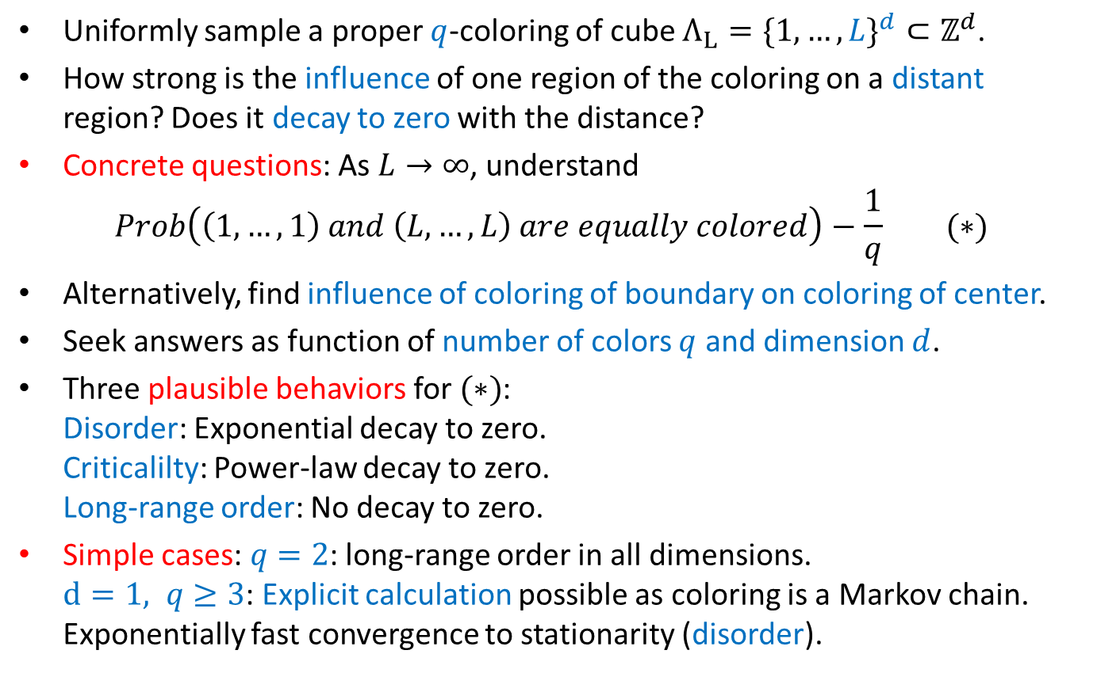

What are we looking for?
Uniformly sample a proper $q$-coloring of cube $Λ_{L}=\{1,…,L\}^{d}⊂ℤ^{d}$.
How strong is the influence of one region of the coloring on a distant region? Does it decay to zero with the distance?
Concrete questions: As $L→∞$, understand
$$Prob\left(\left(1,…,1\right) and \left(L,…,L\right) are equally colored\right)−\frac{1}{q} (∗)$$
Alternatively, find influence of coloring of boundary on coloring of center.
Seek answers as function of number of colors $q$ and dimension $d$.
Three plausible behaviors for $(∗)$:
Disorder: Exponential decay to zero.
Criticalilty: Power-law decay to zero.
Long-range order: No decay to zero.
Simple cases: $q=2$: long-range order in all dimensions.
$d=1, q≥3$: Explicit calculation possible as coloring is a Markov chain. Exponentially fast convergence to stationarity (disorder).
Chessboard order ($q=2)$
Notes:
Three parameters: q, d and L.

Slide 5
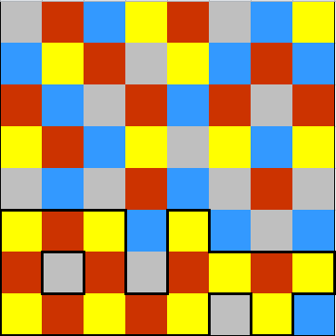
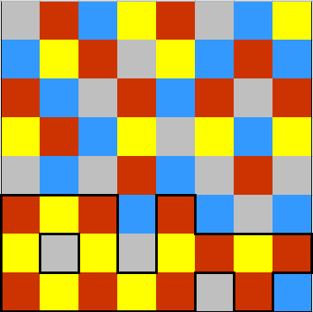
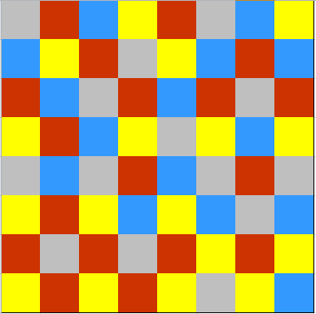
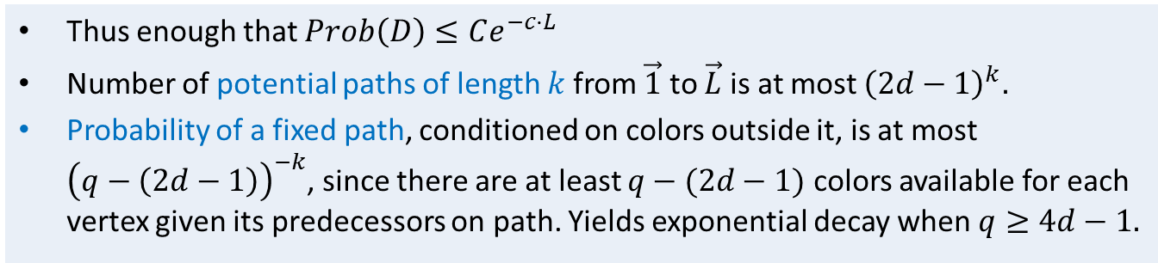
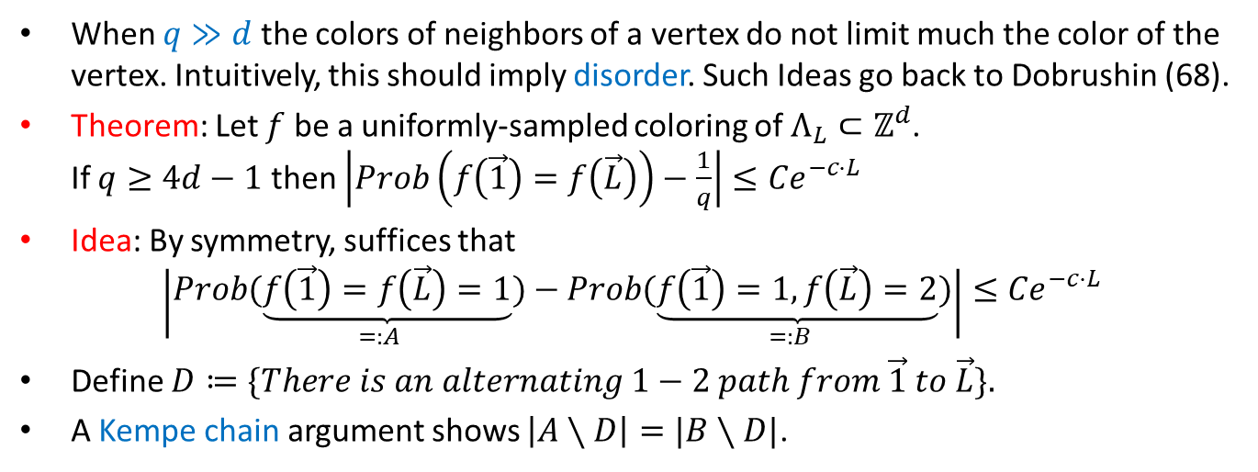
Large number of colors
When $q≫d$ the colors of neighbors of a vertex do not limit much the color of the vertex. Intuitively, this should imply disorder. Such Ideas go back to Dobrushin (68).
Theorem: Let $f$ be a uniformly-sampled coloring of $Λ_{L}⊂ℤ^{d}$.
If $q≥4d−1$ then $\left|Prob\left(f\left(\vec{1}\right)=f\left(\vec{L}\right)\right)−\frac{1}{q}\right|≤{Ce}^{−c⋅L}$
Idea: By symmetry, suffices that
$$\left|Prob\underset{=:A}{(\underbrace{f\left(\vec{1}\right)=f\left(\vec{L}\right)=1}})−Prob\underset{=:B}{(\underbrace{f\left(\vec{1}\right)=1,f\left(\vec{L}\right)=2}})\right|≤{Ce}^{−c⋅L}$$
Define $D≔\{There is an alternating 1−2 path from \vec{1} to \vec{L}\}.$
A Kempe chain argument shows $\left|A∖D\right|=|B∖D|$.
Thus enough that $Prob\left(D\right)≤Ce^{−c⋅L}$
Number of potential paths of length $k$from $\vec{1}$ to $\vec{L}$ is at most ${\left(2d−1\right)}^{k}.$
Probability of a fixed path, conditioned on colors outside it, is at most
${\left(q−\left(2d−1\right)\right)}^{−k}$, since there are at least $q−(2d−1)$ colors available for each vertex given its predecessors on path. Yields exponential decay when $q≥4d−1.$

Slide 6
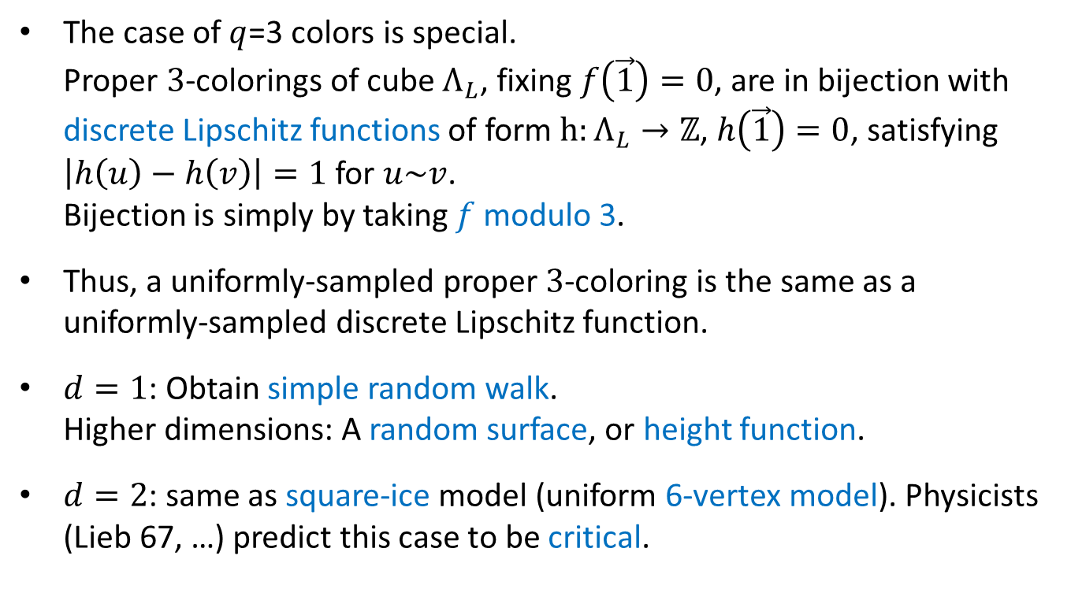
Small number of colors: q=3
The case of $q$=3 colors is special.
Proper $3$-colorings of cube $Λ_{L}$, fixing $f\left(\vec{1}\right)=0$, are in bijection with discrete Lipschitz functions of form $h:Λ_{L}→ℤ$, $h\left(\vec{1}\right)=0$, satisfying $\left|h\left(u\right)−h\left(v\right)\right|=1$ for $u\sim v$.
Bijection is simply by taking $f$ modulo 3.
Thus, a uniformly-sampled proper $3$-coloring is the same as a uniformly-sampled discrete Lipschitz function.
$d=1$: Obtain simple random walk.
Higher dimensions: A random surface, or height function.
$d=2$: same as square-ice model (uniform 6-vertex model). Physicists (Lieb 67, …) predict this case to be critical.

Slide 7
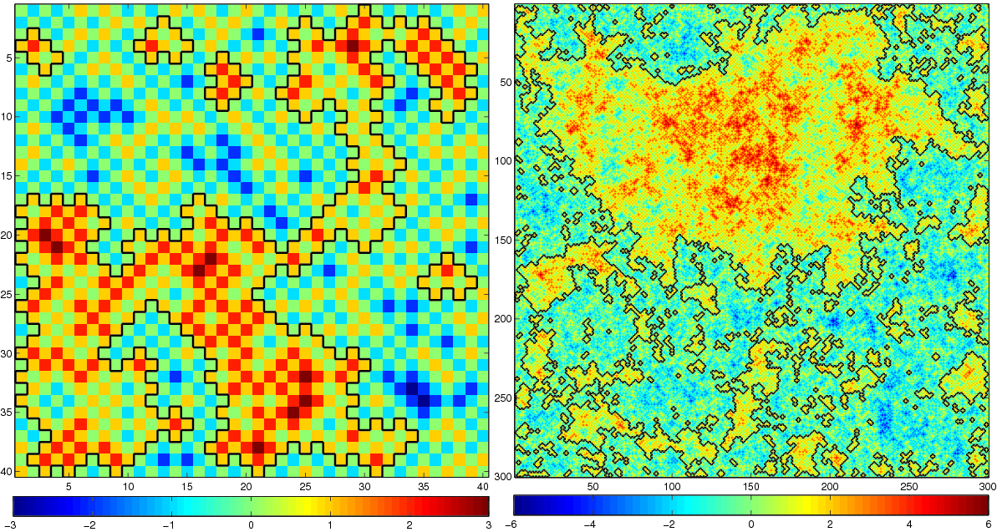
Height function for q=3, d=2
Height function with boundary values fixed to zero on even vertices.
Non-trivial level sets separating heights 0 and 1 are highlighted (black lines).
Conformal invariance conjectured: Gaussian free field scaling limit with level lines scaling to CLE(4).

Slide 8
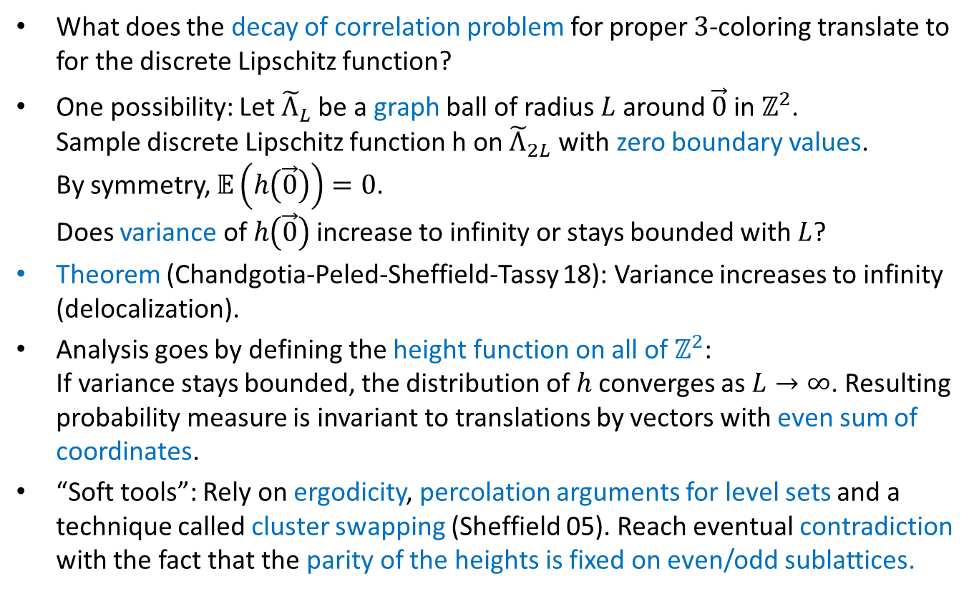
Delocalization for 2D height function
What does the decay of correlation problem for proper $3$-coloring translate to for the discrete Lipschitz function?
One possibility: Let ${\tilde{Λ}}_{L}$ be a graph ball of radius $L$ around $\vec{0}$ in $ℤ^{2}$.
Sample discrete Lipschitz function h on ${\tilde{Λ}}_{2L}$ with zero boundary values.
By symmetry, $𝔼\left(h\left(\vec{0}\right)\right)=0$.
Does variance of$h\left(\vec{0}\right)$ increase to infinity or stays bounded with $L$?
Theorem (Chandgotia-Peled-Sheffield-Tassy 18): Variance increases to infinity (delocalization).
Analysis goes by defining the height function on all of $ℤ^{2}$:
If variance stays bounded, the distribution of $h$ converges as $L→∞$. Resulting probability measure is invariant to translations by vectors with even sum of coordinates.
“Soft tools”: Rely on ergodicity, percolation arguments for level sets and a technique called cluster swapping (Sheffield 05). Reach eventual contradiction with the fact that the parity of the heights is fixed on even/odd sublattices.

Slide 9
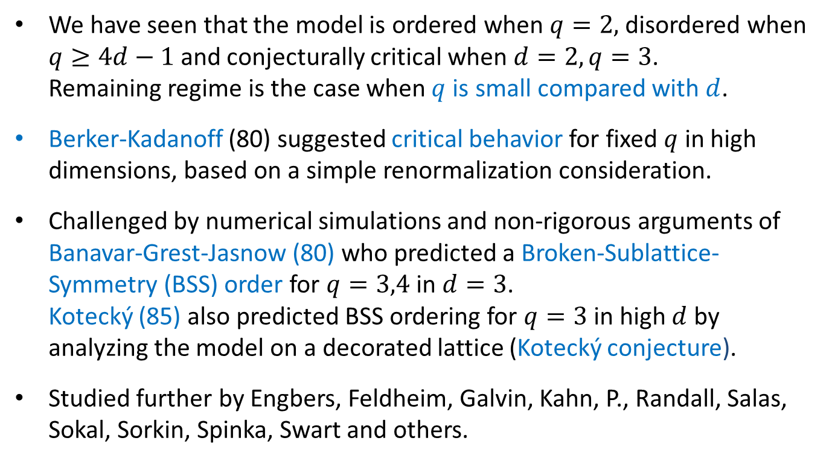

Small $q$ and high $d$
We have seen that the model is ordered when $q=2,$disordered when $q≥4d−1$ and conjecturally critical when $d=2, q=3$.
Remaining regime is the case when $q$ is small compared with $d$.
Berker-Kadanoff (80) suggested critical behavior for fixed $q$ in high dimensions, based on a simple renormalization consideration.
Challenged by numerical simulations and non-rigorous arguments of Banavar-Grest-Jasnow (80) who predicted a Broken-Sublattice-Symmetry (BSS) order for $q=3,4$ in $d=3$.
Kotecký (85) also predicted BSS ordering for $q=3$ in high $d$ by analyzing the model on a decorated lattice (Kotecký conjecture).
Studied further by Engbers, Feldheim, Galvin, Kahn, P., Randall, Salas, Sokal, Sorkin, Spinka, Swart and others.

Slide 10
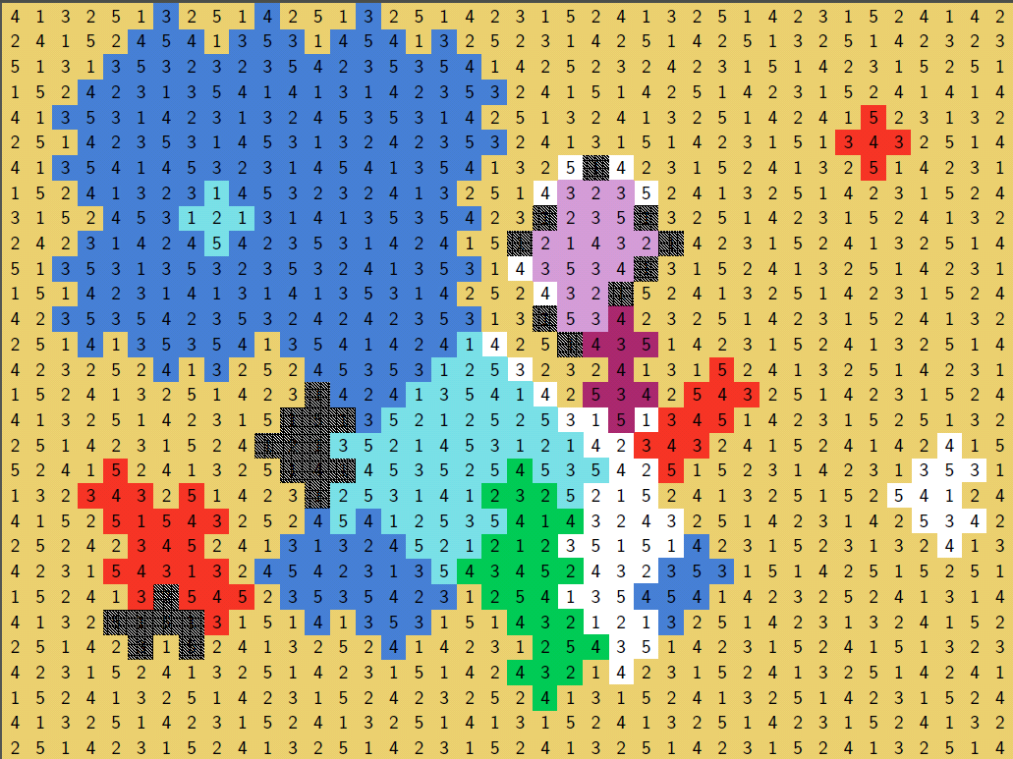
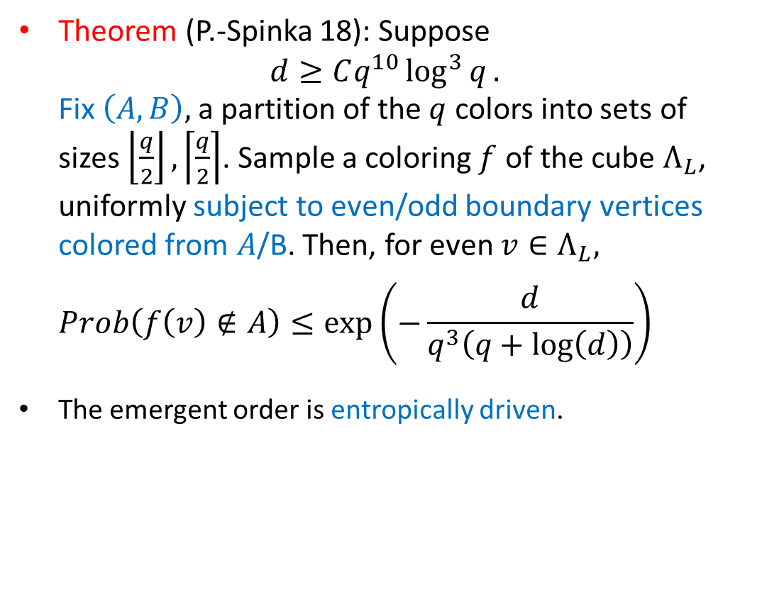
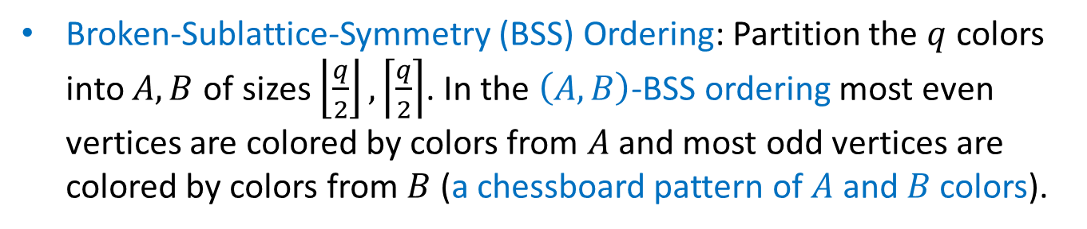
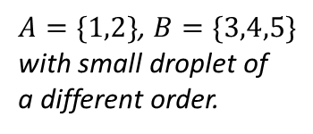
Ordering - rigorous result
Broken-Sublattice-Symmetry (BSS) Ordering: Partition the $q$ colors into $A,B$ of sizes $\left\lfloor \frac{q}{2}\right\rfloor ,\left\lceil \frac{q}{2}\right\rceil$. In the $\left(A,B\right)$-BSS ordering most even vertices are colored by colors from $A$ and most odd vertices are colored by colors from $B$ (a chessboard pattern of $A$ and $B$ colors).
Theorem (P.-Spinka 18): Suppose
$d≥Cq^{10}\log^{3}{q}.$
Fix $\left(A,B\right),$a partition of the $q$ colors into sets of sizes $\left\lfloor \frac{q}{2}\right\rfloor ,\left\lceil \frac{q}{2}\right\rceil$. Sample a coloring $f$ of the cube $Λ_{L}$, uniformly subject to even/odd boundary vertices colored from $A$/B. Then, for even $v∈Λ_{L},$
$Prob\left(f\left(v\right)∉A\right)≤\exp\left(−\frac{d}{q^{3}\left(q+\log\left(d\right)\right)}\right)$
and similarly for odd $v∈Λ_{L}$ with $A$ replaced by B.
The emergent order is entropically driven.
$A=\{1,2\}$, $B=\{3,4,5\}$
with small droplet of
a different order.

Slide 11
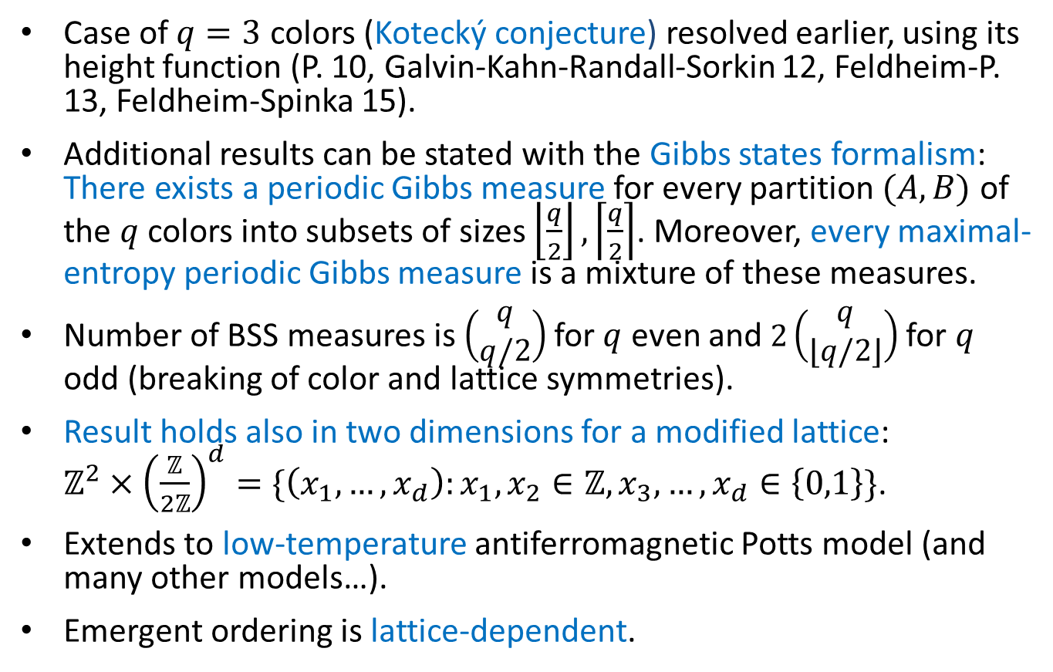
Remarks
Case of $q=3$ colors (Kotecký conjecture) resolved earlier, using its height function (P. 10, Galvin-Kahn-Randall-Sorkin 12, Feldheim-P. 13, Feldheim-Spinka 15).
Additional results can be stated with the Gibbs states formalism: There exists a periodic Gibbs measure for every partition $(A,B)$ of the $q$ colors into subsets of sizes $\left\lfloor \frac{q}{2}\right\rfloor ,\left\lceil \frac{q}{2}\right\rceil$. Moreover, every maximal-entropy periodic Gibbs measure is a mixture of these measures.
Number of BSS measures is $\left(\begin{matrix}q \\ q/2\end{matrix}\right)$for $q$ even and $2\left(\begin{matrix}q \\ ⌊q/2⌋\end{matrix}\right)$ for $q$ odd (breaking of color and lattice symmetries).
Result holds also in two dimensions for a modified lattice:
$ℤ^{2}×{\left(\frac{ℤ}{2ℤ}\right)}^{d}=\{\left(x_{1},…,x_{d}\right):x_{1},x_{2}∈ℤ, x_{3},…,x_{d}∈\left\{0,1\right\}\}$.
Extends to low-temperature antiferromagnetic Potts model (and many other models…).
Emergent ordering is lattice-dependent.
Notes:
E.g., for each $q$ may modify square lattice by replacing each edge by many parallel paths of length 2, to obtain lattice on which proper $q$-coloring orders by having a single color on most vertices of original square lattice (Huang et. al., PRE 2013).
Qin et. al. (PRB 2014) find partial long-range order in certain cases.
Our result is the first to treat the standard $ℤ^{d}$ lattice.

Slide 12
Ideas of proof for proper colorings
Wish to implement a Peierls-type argument:
1) Find ordered/disordered regions and domain walls in coloring.
2) Show that the probability of any given set of contours being the domain walls is exponentially small in their total length.
3) Sum over contours to conclude that no long contours arise.
Problems:
1) How to define ordered regions?
2) How to bound probability of a given set of contours?
2) Too many contours to sum over.
Solutions:
1) Classify vertices to ordered regions by the colors of their neighbors.
2) Use entropy inequality (Shearer’s inequality) to quantify the amount by which the BSS ordering is locally optimal.
Use to bound probability of given contour picture.
3) Prove that relevant class of contours allows for coarse graining.

Slide 13
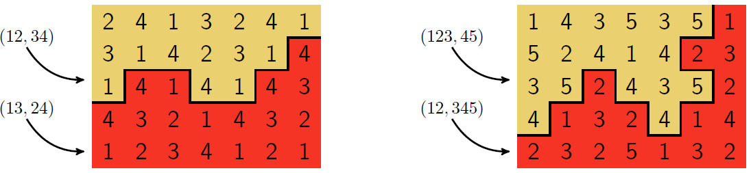
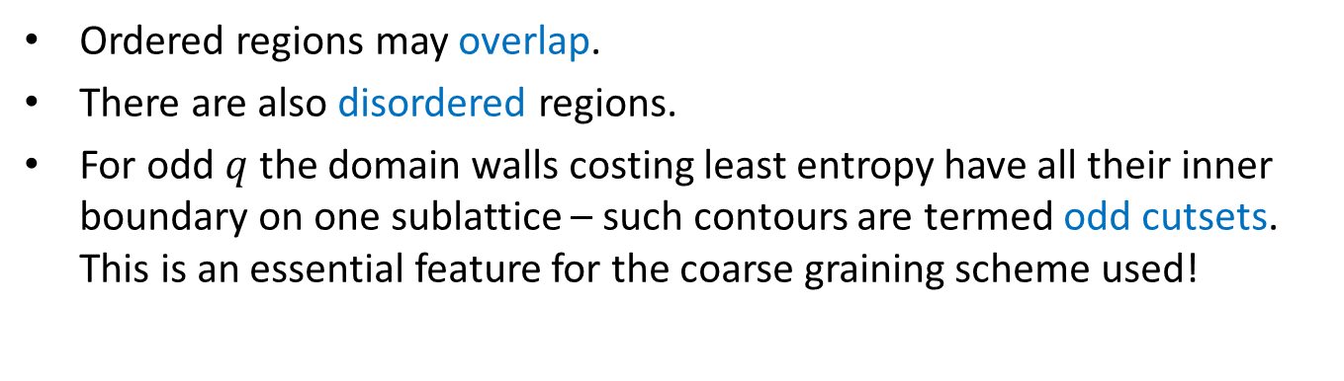


Ordered regions and domain walls
$$q=4$$
$$q=5$$
Ordered regions may overlap.
There are also disordered regions.
For odd $q$ the domain walls costing least entropy have all their inner boundary on one sublattice – such contours are termed odd cutsets.
This is an essential feature for the coarse graining scheme used!

Slide 14
Classification to ordered/disordered regions
Colors – orderings. White – disordered. Black – overlap

Slide 15
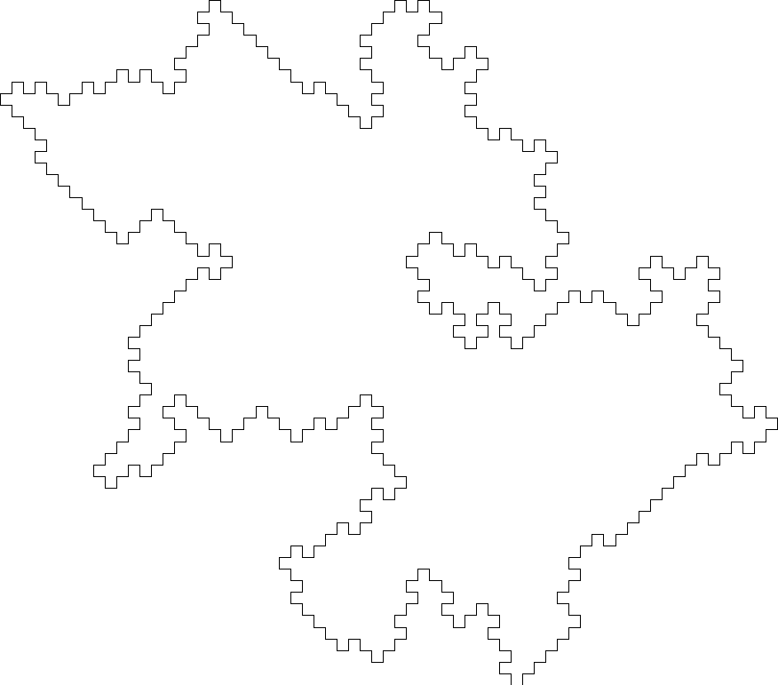
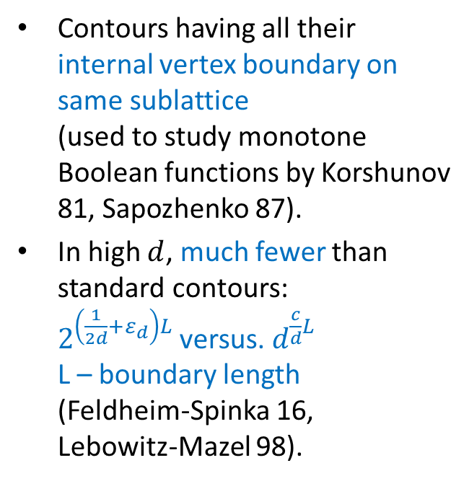
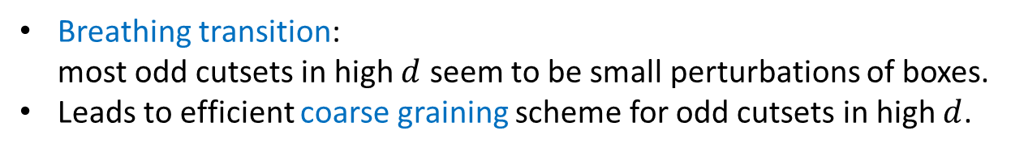
Odd cutsets
Contours having all their internal vertex boundary on same sublattice
(used to study monotone Boolean functions by Korshunov 81, Sapozhenko 87).
In high $d$, much fewer than standard contours:
$2^{\left(\frac{1}{2d}+ε_{d}\right)L}$ versus. $d^{\frac{c}{d}L}$
L – boundary length
(Feldheim-Spinka 16,
Lebowitz-Mazel 98).
Breathing transition:
most odd cutsets in high $d$ seem to be small perturbations of boxes.
Leads to efficient coarse graining scheme for odd cutsets in high $d$.

Slide 16
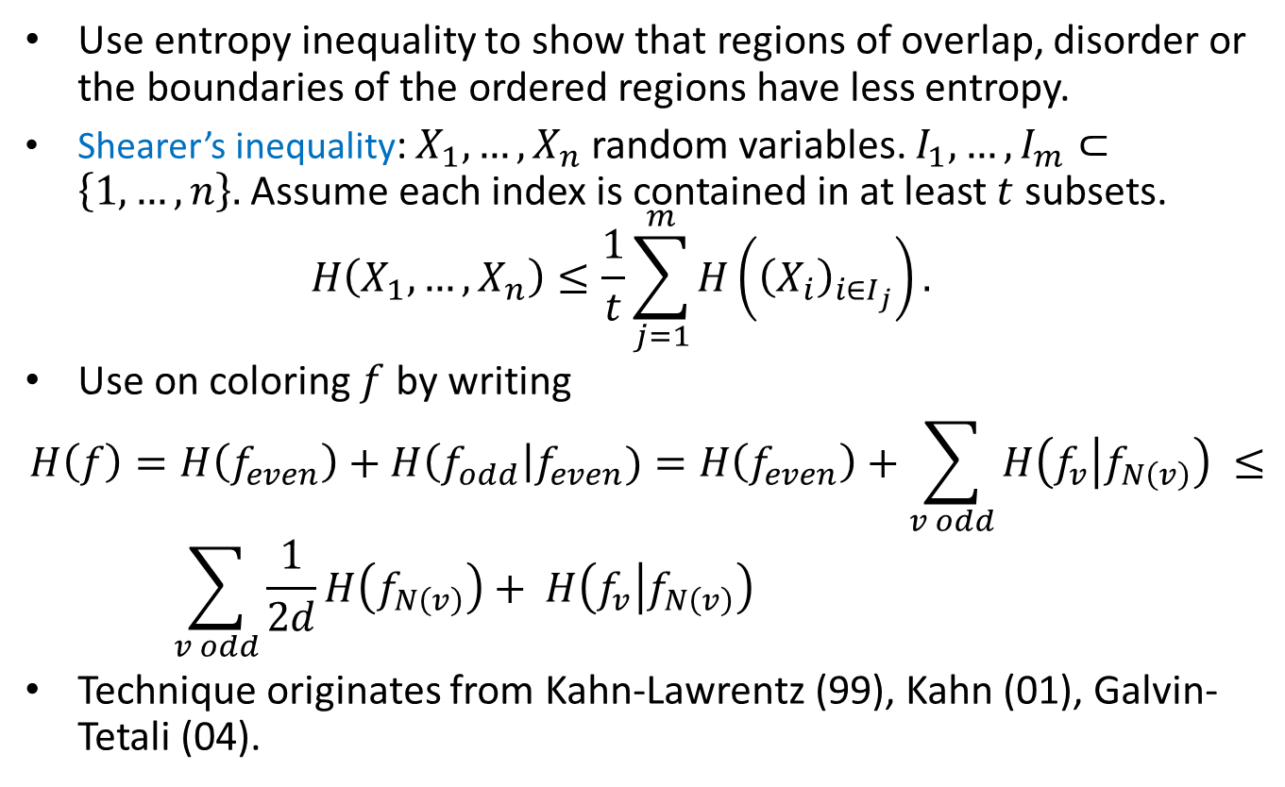
Regions of low entropy
Use entropy inequality to show that regions of overlap, disorder or the boundaries of the ordered regions have less entropy.
Shearer’s inequality: $X_{1},…,X_{n}$ random variables. $I_{1},…,I_{m}⊂\left\{1,…,n\right\}.$ Assume each index is contained in at least $t$ subsets.
$H\left(X_{1},…,X_{n}\right)≤\frac{1}{t}\sum_{j=1}^{m}{H\left({\left(X_{i}\right)}_{i∈I_{j}}\right)}.$
Use on coloring $f$ by writing
$$H\left(f\right)=H\left(f_{even}\right)+H\left(f_{odd}\right|f_{even})=H\left(f_{even}\right)+\sum_{v odd}{H\left(f_{v} | f_{N\left(v\right)}\right)} ≤ \\ \sum_{v odd}{\frac{1}{2d}H\left(f_{N\left(v\right)}\right)+ H\left(f_{v} | f_{N\left(v\right)}\right)}$$
Technique originates from Kahn-Lawrentz (99), Kahn (01), Galvin-Tetali (04).
Notes:
Works in 2d-regular graphs. Additional difficulty in applying to domains with boundary.

Slide 17

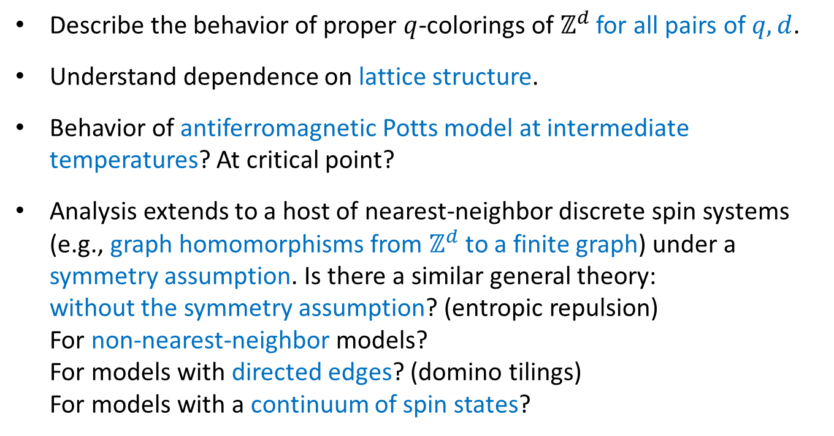
Open questions
Describe the behavior of proper $q$-colorings of $ℤ^{d}$ for all pairs of $q,d$.
Understand dependence on lattice structure.
Behavior of antiferromagnetic Potts model at intermediate temperatures? At critical point?
Analysis extends to a host of nearest-neighbor discrete spin systems (e.g., graph homomorphisms from $ℤ^{d}$ to a finite graph) under a symmetry assumption. Is there a similar general theory:
without the symmetry assumption? (entropic repulsion)
For non-nearest-neighbor models?
For models with directed edges? (domino tilings)
For models with a continuum of spin states?

